Slide 1
Parts of Speech

Slide 2

What Does Part of Speech Mean?
Words are divided into different kinds or classes, called Parts of Speech, according to their use; that is, according to the work they do in a sentence.

Slide 3

The Eight Parts of Speech
Noun
Pronoun
Verb
Adverb
Adjective
Preposition
Conjunction
Interjection

Slide 4
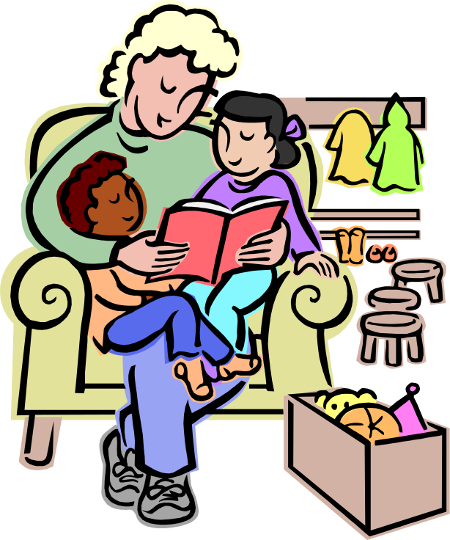
Noun
A Noun is a word used as the name of a person, place, or thing; as,
Akbar was a great King.
Kolkata is on the Hooghly.
The rose smells sweet.
The sun shines bright.
His courage won him honour.

Slide 5
Pronoun
A Pronoun is a word used instead of a noun; as,
John is absent, because he is ill.
They went to the museum.
It is an endangered species now.
The book are where you left them

Slide 6
EX.
1. Look at Mike. Mike is a good boy.
2. Mike loves to study. Mike is good at skating.
Instead of Mike we can use 'he'.
Now read these sentences again:
1. Look at Mike. He is a good boy.
2. He loves to study. He is good at skating.

Slide 7
Verb
A Verb is a word used to express an action or state; as
The girl wrote a letter to her cousin.
Kolkata is a big city.
Iron and copper are useful metals.

Slide 8

Adverb
An Adverb is a word used to add something to the meaning of a verb, an adjective, or another adverb; as,
He worked the sum quickly.
I had a letter from him lately.
She pronounced the word quite correctly.

Slide 9
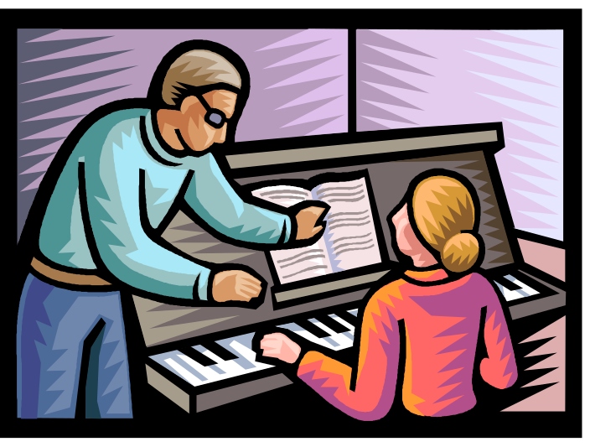
Adjective
An Adjective is a word used to add something to the meaning of a noun; as,
He is a brave boy.
There are twenty boys in this class.
He writes meaningless letters.

Slide 10

Prepositions
A Preposition is a word used with a noun or a pronoun to show how the person or thing denoted by the noun or pronoun stands in relation to something else; as,
There is a cow in the garden.
The girl is fond of music.
A fair little girl sat under a tree.

Slide 11
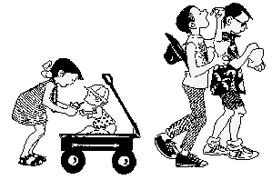
Conjunction
A Conjunction is a word used to join words or sentences; as,
You will pass if you work hard.
Two and two make four.
I ran fast, but missed the train.

Slide 12
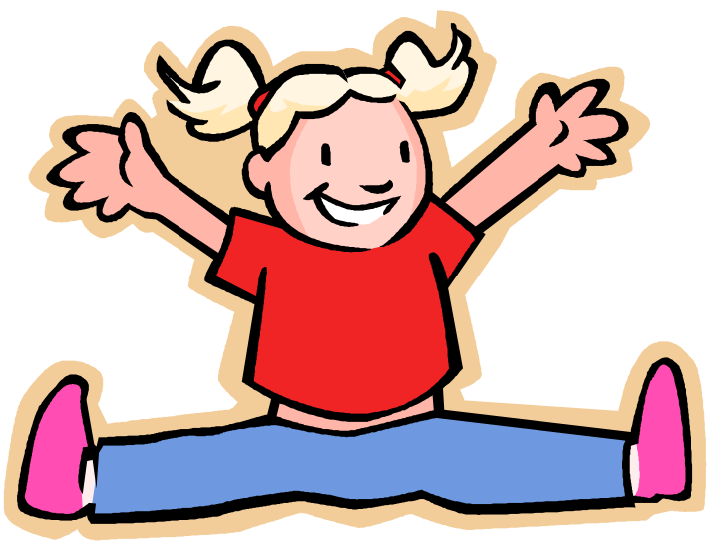
Interjection
An Interjection is a word which expresses some sudden feeling; as,
Hurrah! We have won the game.
Alas! She is dead.

Slide 13
Exercise
1. Still waters run deep.
3. After the storm comes the calm.
4. The after effects of the drug are bad.
6. He is a nice person.
5.Ah! Have they gone?
2. He lives in that house.

Slide 14
7. He told us about the battle.
12. He is in the committee.
11. She must weep, or she will die
10. Mohammedans fast in the month of Ramzan.
9. Suddenly one of the wheels came off.
8.This sum is more difficult.

